Slide 1
21ST CENTURY ARTISTS
Paintings of Women in Black and White

Slide 2
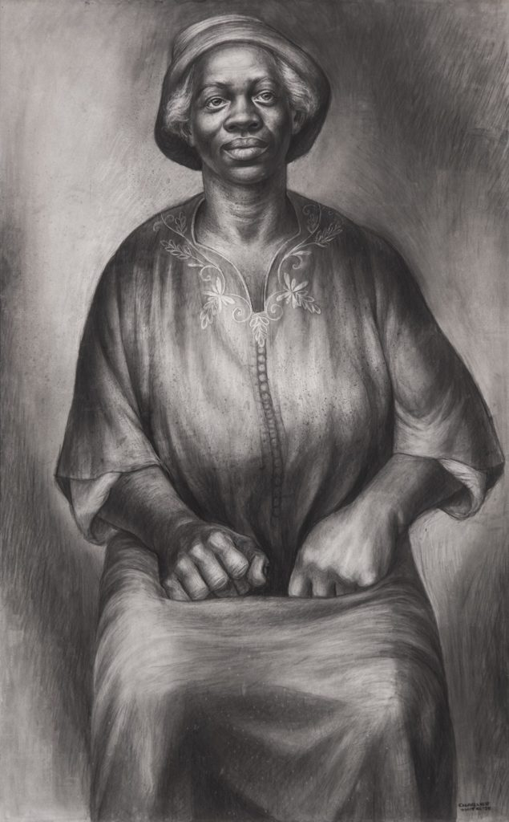
Charles White
Title: I Been Rebuked & I Been Scorned (Solid as a Rock) (1954)
Dimensions; 43 1/2 × 27 1/4 in
Notes:
Charles White was an American artist known for his love for African American related subjects in paintings, lithographs, and murals (Lewis, 2019).
White subscribes to the style of Abstract Expressionism (Lewis, 2019)
Image description: Wolff crayon and charcoal on Anjac illustration board, dimensions; 43 1/2 × 27 1/4 in vs 110.5 × 69.2 cm

Slide 3
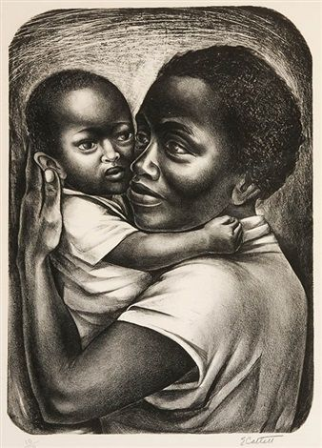
Elizabeth Catlett
Title: Black Maternity
Details: Black Maternity, 1959
Lithograph, 470 x 343 mm
(18-1/2 x 13-1/2 in)
Signed, 10/50
Notes:
Elizabeth Catlett was an American and Mexican graphic artist and sculptor best known for her depictions of the African-American experience in the 20th century, which often focused on the female experience ("Black Maternity - ELIZABETH CATLETT | william p. carl - fine prints", 2019).
The painting shows a young black woman holding her newborn child to her chest, their cheeks touching.
The artwork was signed and numbered in pencil and is a fine impression of this rare early work ("Black Maternity - ELIZABETH CATLETT | william p. carl - fine prints", 2019).
The margins are full and the condition is excellent.

Slide 4
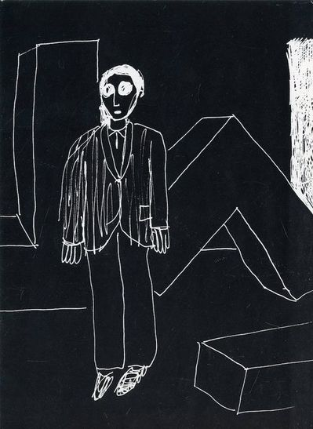
Peter Halley
Title: P.S. 122, Peter Halley, Post Classical Paintings and Drawings
Notes:
This is ephemera, an artifact related to the artist ("Peter Halley, Post Classical Paintings and Drawings", 2019).
Peter Halley is best known for his brightly colored, geometric paintings made.
Halley engages in a play of relationships between what he calls “prisons” and “cells”—composed of rectangular shapes and vertical bars—evocative of geometric networks from the urban grid to high-rise apartment buildings to electromagnetic conduits ("Peter Halley, Post Classical Paintings and Drawings", 2019)..
This artwork has rigid planes of color, unitary shapes, and non-hierarchical compositions nod toward minimalism, by transforming the Minimalist square into a prison cell, Halley’s works call the supposed neutrality of such art into question ("Peter Halley, Post Classical Paintings and Drawings", 2019)..

Slide 5
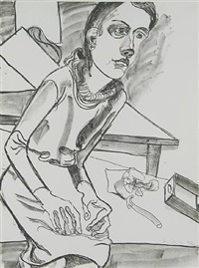
Alice Neel
Tile: Nancy, 1977, Sragow Gallery
Details: Lithograph, 30 1/16 x 22 5/16 in.
Notes:
Alice Neel was an American visual artist, who was known for her portraits depicting friends, family, lovers, poets, artists and strangers ("SRAGOW GALLERY New York: Alice Neel", 2019).
Her paintings have an expressionistic use of line and color, psychological acumen, and emotional intensity ("SRAGOW GALLERY New York: Alice Neel", 2019).

Slide 6
References
1994.6 – Ai Weiwei. (2019). Retrieved from https://allpainters.org/paintings/1994-6-1994-ai-weiwei.html
Black Maternity - ELIZABETH CATLETT | william p. carl - fine prints. (2019). Retrieved from http://www.williampcarlfineprints.com/pieces/1892_Black_Maternity
Lewis, Z. (2019). I’ve been ‘Buked and I’ve been Scorned, Charles White, 1956. Retrieved from https://cejjesinstitute.org/ive-been-buked/
Peter Halley | P.S. 122, Peter Halley, Post Classical Paintings and Drawings, Card (1983) | Available for Sale | Artsy. (2019). Retrieved from https://www.artsy.net/artwork/peter-halley-ps-122-peter-halley-post-classical-paintings-and-drawings-card
Senza titolo by WolfVostell. (2019). Retrieved from http://www.artnet.com/artists/wolf-vostell/senza-titolo-IXn3Tx5v8wYlSSIae7JdsA2
SRAGOW GALLERY New York: Alice Neel. (2019). Retrieved from http://www.artnet.com/galleries/sragow-gallery/artist-alice-neel/
Weiwei, A. (2019). Ai Weiwei: The artwork that made me the most dangerous person in China. Retrieved from https://www.theguardian.com/artanddesign/2018/feb/15/ai-weiwei-remembering-sichuan-earthquake

Slide 7
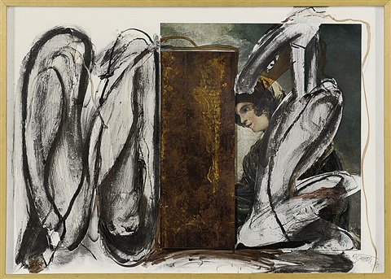
Wolf Vostell
Title: Senza titolo , 1988
Details: mixed media and collage on wood and iron, 29.1 x 40.2 x 1.2 in.
Notes:
Wolf Vostell was a German painter and sculptor, considered one of the early adopters of video art and installation art and pioneer of Happening and Fluxus ("Senza titolo by WolfVostell", 2019).
Techniques such as blurring and Dé-coll/age are characteristic of his work, as is embedding objects in concrete and the use of television sets in his works ("Senza titolo by WolfVostell", 2019).

Slide 8
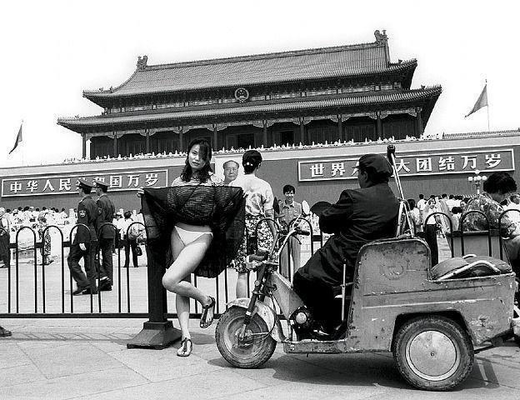
Ai Weiwei
Title: 1994.6 Style: Conceptual Art ("1994.6 – Ai Weiwei", 2019)
Notes:
Ai Weiwei is a Chinese contemporary artist and activist (Weiwei, 2019).
As an activist, he calls attention to human rights violations on an epic scale; as an artist, he expands the definition of art to include new forms of social engagement (Weiwei, 2019).

